Slide 1
Causal Inference for Right Heart Catheterization (RHC) using the SUPPORT Dataset

Slide 2
Cross-Method Consistency in Estimating the Average Treatment Effect of Right Heart Catheterization
Gabrielle Kraft - Smith College
Aditya Krishnan - University of North Carolina Chapel Hill
Akshay Kumar - Harvard University

Slide 3
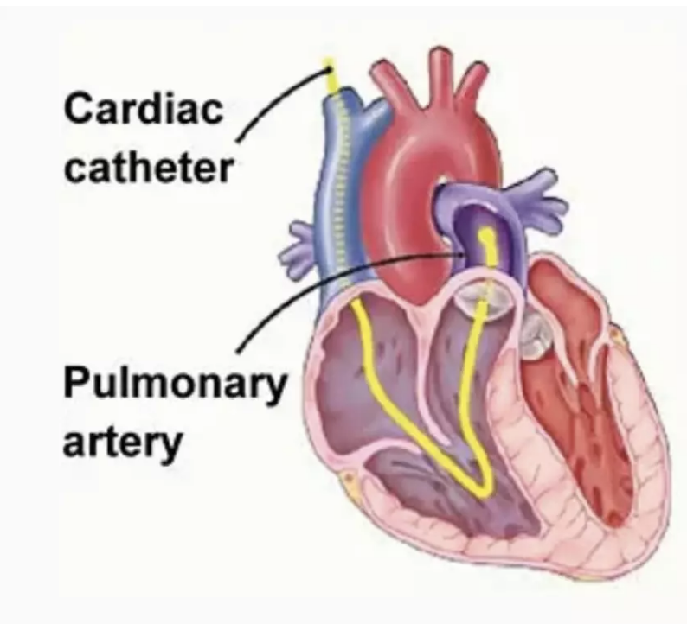
Right Heart Catheterization (RHC)
Invasive diagnostic procedure that is done to assess pressure in the pulmonary artery and right heart through a catheter¹
Heart failure
Pulmonary hypertension
Cardiogenic shock
One of the most widely used cardiac procedures¹
40% of critically ill patients had it done in 1980s²
Over 1 million people in 2022²
Benefits are long-debated and unclear²
¹Manda & Baradhi, 2023
²Katbamna et al., 2024
Notes:
https://www.ncbi.nlm.nih.gov/books/NBK531461/
https://pmc.ncbi.nlm.nih.gov/articles/PMC10352814/#b4
20-40% of critically ill patients in the mid 1980s got RHC https://jamanetwork.com/journals/jama/fullarticle/208067
The 5735 patients included in the Connors Study were admitted to or transferred to an ICU in the first 24 hours after entering the study
All patients had detailed chart abstraction done - diagnoses were recorded and the most abnormal value 24 hours after entry were recorded for values like HR, Resp, BP, Arterial gases etc.
https://www.ncbi.nlm.nih.gov/books/NBK557404/
https://www.hey.nhs.uk/patient-leaflet/right-heart-catheterisation/

Slide 4
SUPPORT Study, 1989-1994
Observational data from 5,735 ICU patients at five teaching hospitals in the United States.³
Admission criteria:
High-mortality risk (>50%)
9 pre-specified disease categories*
Hospitalized in the intensive care unit
Patient outcomes followed for 6 months after admission
180 day mortality rate: 49.3%
³Connors et al., 1995
*Acute respiratory failure (ARF), Chronic Obstructive Pulmonary Disease (COPD), Congestive Heart Failure (CHF), Liver disease, Colon cancer, Coma, Lung cancer, Multiple Organ System Failure with Malignancy (MOSF w/Malignancy) and Multiple Organ System Failure with Sepsis (MOSF w/Sepsis).
Notes:
SUPPORT - Study to understand prognoses and preferences for outcomes and risks of treatment
Phase I had 4301 patients and Phase II had 4804 patients with their physicians being randomized by specialty group to intervention (n = 2652) or control groups (n = 2152)
Phase I was observational and involved collecting detailed clinical data, patient preferences, survival predictions and care received with the idea of identifying problems in care like poor communication, inaccurate survival estimates by physicians and aggressive treatments near death
Phase II was an RCT that involved intervention in the form of specially trained nurses who facilitated discussions between patients, families, and clinicians about prognosis, preferences and care plans - control received usual care
https://pubmed.ncbi.nlm.nih.gov/7474243/

Slide 5
The Dataset
55 Covariates | Treatment | Outcome
Patient demographics Health history Physiological information and panels | RHC - binary treatment indicator that is set to 1 if present within the first 24 hours of hospitalization | Binary variable representing 180 day mortality
Target population: high mortality risk ICU patients in 9 pre-specified disease categories in American teaching hospitals between 1989 and 1994

Slide 6
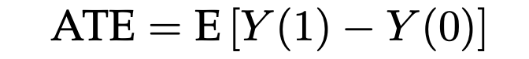
Defining the Average Treatment Effect (ATE)
Define Y(0) and Y(1) to be the potential outcomes of a given patient under no treatment and treatment, respectively
Let W ∈ {0, 1} denote that patient's treatment status, where W = 1 indicates treatment (RHC) and W = 0 indicates no treatment (no RHC)
The observed outcome is Y ≡ Y(W), and the unobserved counterfactual is Y(1 – W)
X ∈ ℝ⁵² is a patients vector of pre-treatment covariates
The average treatment effect (ATE) is the average difference between the outcome under treatment and the outcome under no treatment for a given patient.⁴ Mathematically, ATE is given by
Our outcome is a binary variable corresponding to 180 day mortality: 1 indicates death and 0 indicates survival
⁴Naimi & Whitcomb, 2023
Notes:
https://academic.oup.com/aje/article/192/5/685/6991423
E.g. Y(1) = 1 indicates patient death within 180 days of receiving RHC.

Slide 7
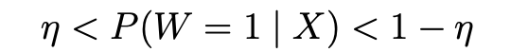
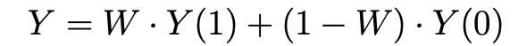
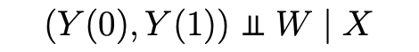
Assumptions⁴
Positivity/Strong Overlap:
SUTVA/Consistency:
Exchangeability/Unconfoundedness:
³Naimi & Whitcomb, 2023
Notes:
positivity: we observe some exposed and some unexposed treatments;
This is a reasonable assumption: We have a large number of patients in both the treatment and control groups, and the two cohorts overlap significantly in the covariates.
No interference between patients:
No hidden variation in treatment:
No hidden variation:
After we adjust for baseline covariates, treated and control patients are comparable, so that no systematic differences remain besides the treatment itself, and thus, for example, the control group’s outcomes serve as the best proxy for what treated patients would have experienced without RHC.

Slide 8
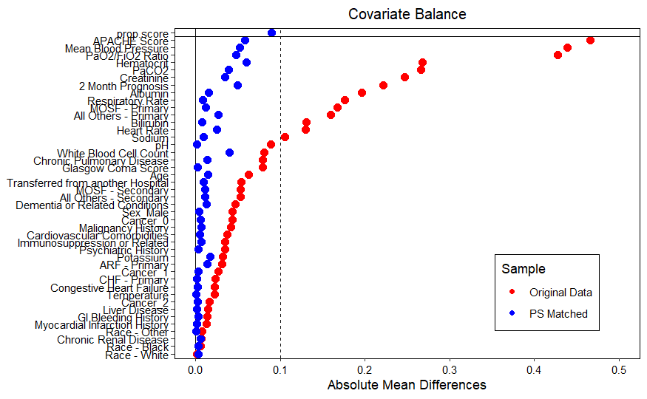
Estimators
Propensity Score Matching
Probability of receiving treatment given known and suspected confounders using a logistic regression model
Like with like: patients are matched based on propensity score and disease category
Intuitive, widely used in clinical research⁵
⁵Austin, 2011
Notes:
Propensity score matching– original method used on this dataset (0.0492). Adjusts for confounders in the propensity score calculation, then matches patients from opposing treatment groups based on propensity score similarity. (Freq, design based) Also requires very careful and accurate confounding identification.
Covariate balance - Creates matched sets with similar covariates
Reduces confounding - Adjusts for confounding in observed variables
Mimics randomization - Aligning distribution of covariates across groups
Decreased sample size - Not all patients will be matched and these patients will be discarded
Adjusts for observed confounders - Can’t adjust for unobserved confounders so hidden bias might be there

Slide 9
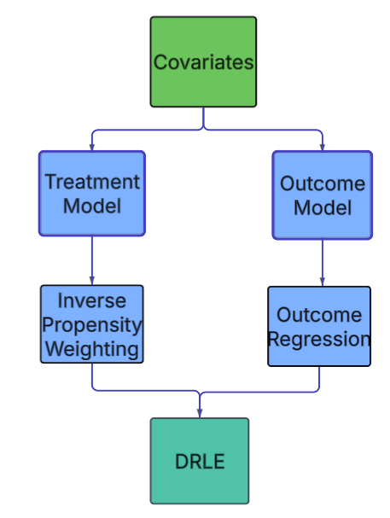
Estimators
Propensity Score Matching
Doubly Robust Logistic Estimator
Combines two logistic models: one for assigning treatment and one for modeling the outcome and the counterfactual⁶
⁶Funk et al., 2011
Notes:
DR - Combines outcome regression with propensity score weighting which allows the model to be consistent if either the outcome or propensity model is correct.
Only one of the two models need to be correct to get a consistent estimate for ATE, it mitigates confounding through the use of both models and it is flexible with a lot of different machine learning models
If both models are incorrect, DR becomes biased and it can be more complex to implement

Slide 10
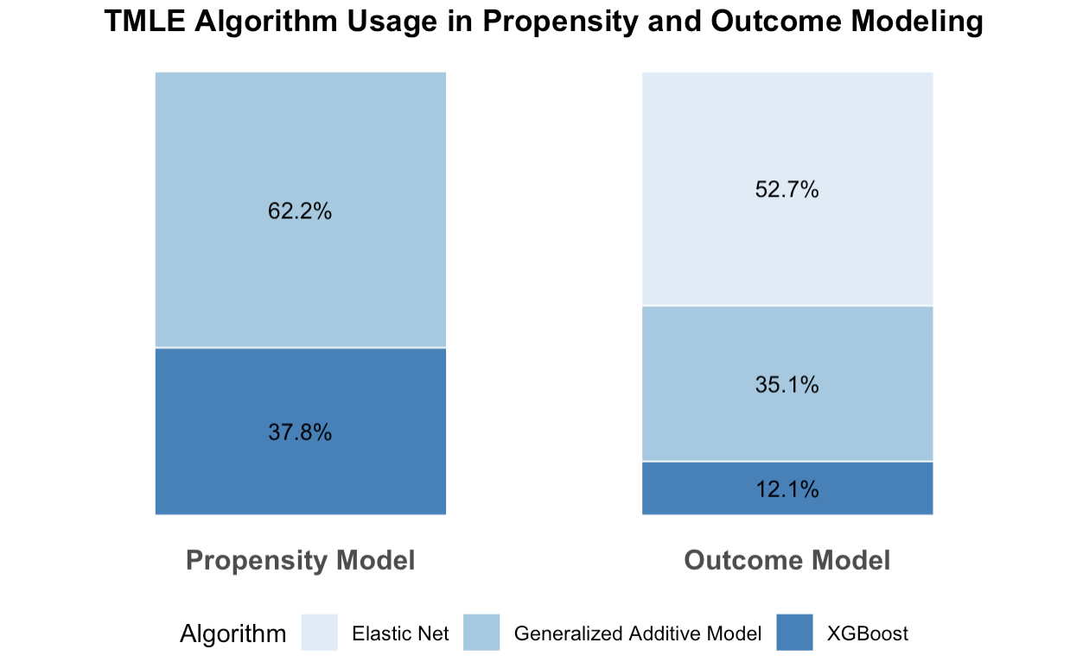
Estimators
Propensity Score Matching
Doubly Robust Logistic Estimator
Targeted Maximum Likelihood Estimation
Finds the “optimal” algorithmic combination to model both treatment propensity and predicted outcome under treatment and non-treatment using SuperLearner⁷
Doubly robust
Averages the difference in patients’ predicted outcomes if treated and untreated
⁷Luque-Fernandez et al.., 2011
Notes:
GAM: Non-linear modeling that allows for complex relationships
XGBOOST: iteratively builds decision tree models that learn from their predecessors prediction errors, making a stronger model
Elastic net: Linear model that penalizes overfitting
TMLE - Cross validated superlearner, a machine learning tool, takes the given set of confounders and models them as a function of the outcome. Super learner also estimated the probability of treatment given the set of confounders and then balanced the two patient groups by weighting these scores. This makes TMLE doubly robust, since it accounts for both treatment and outcome confounding. One of the core strengths of this method is that it can use both linear and additive modeling, which allows for more flexibility. Additive models were used for 100% of the propensity scoring and 50% of the outcome modeling
It is flexible with different machine learning algorithms, can be very efficient (combines MLE and targeting) and the additional targeting step ensuring that its estimate focuses on the causal quantity
It can be computationally intensive and difficult to implement

Slide 11
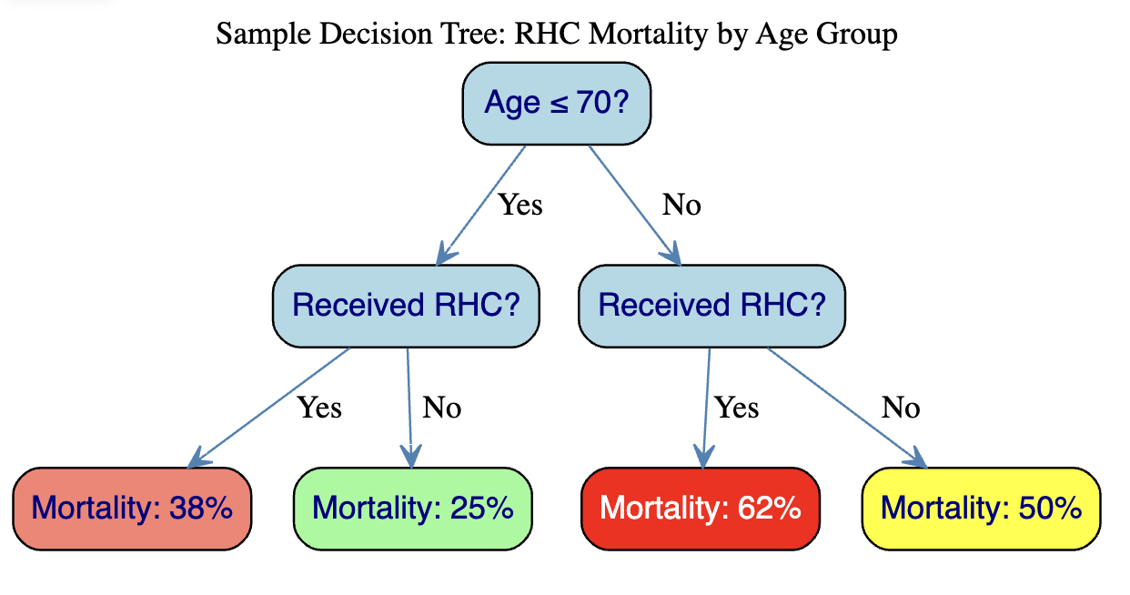
Sample Regression Tree: RHC Mortality by Age Group
Estimators
Propensity Score Matching
Doubly Robust Logistic Estimator
Targeted Maximum Likelihood Estimation
Bayesian Additive Regression Trees
Builds decision trees to identify treatment effects within subgroups (e.g. adults over 50 with heart failure)⁸
Predicts treatment and non-treatment mortality for each patient
Averages the difference in treatment effects across all trees
⁸Tan & Roy, 2020
Notes:
BART models the outcome with all confounders nonlinearly, meaning that variables can flexibly interact with the outcome. Based on what it observes in the data, it then predicts the counterfactual, or what would happen if a patient were given the opposite treatment. BART repeats this counterfactual process thousands of times, and then averages each iteration’s ATE to get the final ATE. This method is strong because it articulates uncertainty, is doubly robust, and also captures any subgroups where treatment might be the most helpful.
It allows for flexible modeling, can quantify uncertainty and be regularized through priors (less overfitting)
It can be computationally intensive and harder to interpret compared to simpler models (harder to interpret coefficients)

Slide 12
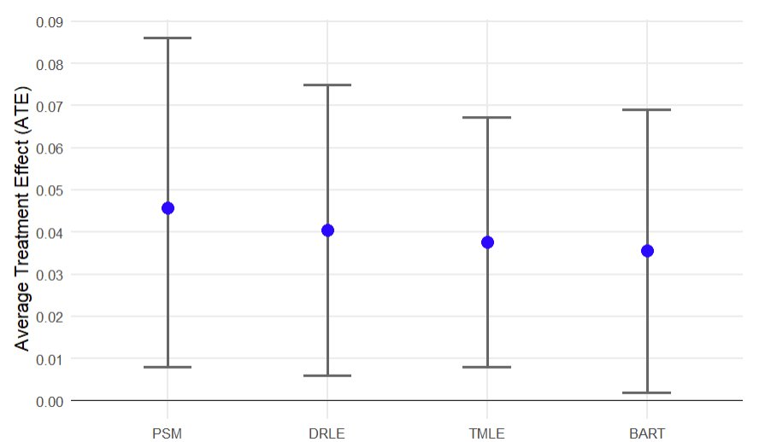
Findings
Key Takeaway:
Estimates for ATE for all the models are similar; logistic models estimate higher mortality risk compared to flexible models like TMLE and BART.
ATE [95% CI] | 0.046 [0.008, 0.086] | 0.041 [0.006, 0.075] | 0.038 [0.008, 0.067] | 0.036 [0.002, 0.070]*
* Represents 95% Credible Interval
Notes:
DR takes the aggregate of CATEs to estimate ATE
GComp is bootstrapped, 1000 reps
Higher ATE = Adjust less compared to lower ATE estimates (Stronger adjustments = lower ATE) -> Why PS Matching and TMLE have higher ATE estimates compared to BART and DR-Learner
In addition, they are not as conservative/careful (extrapolates, doesn’t handle uncertainty as well) as BART/DR-learner, which means that BART/DR-learner is better at measuring heterogeneity and CATE compared to just ATE by itself
Higher ATE = Increased mortality

Slide 13
Key Takeaways
RHC may be harmful procedure that increases mortality risk for ICU patients with 9 prespecified disease categories in American teaching hospitals from 1989-1994
All models demonstrate a 3.6-4.6% increased risk for mortality associated with RHC
Flexible models like TMLE and BART had marginally lower point estimates for ATE compared to logistic models like PSM and DRLE
Careful, contextual selection of models is important for estimating treatment effects

Slide 14
Beyond ATE

Slide 15
How can modern causal ML methods estimate Conditional Average Treatment Effect (CATE) to identify which patients benefit from Right Heart Catheterization (RHC)?
Ria Bhandari - University of California, Davis
Saptashwa Baisya - Indian Statistical Institute, Kolkata

Slide 16
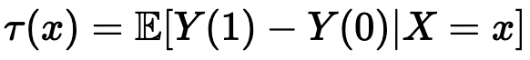
A concept that measures how the effect of a treatment varies across individuals or subgroups.
Goal
Identify subgroups who benefit from RHC by capturing Treatment Effect Heterogeneity (HTE).
What is HTE (Treatment Effect Heterogeneity)?
Quantifying HTE through Conditional Average Treatment Effect (CATE)
Quantifies how a treatment changes expected outcome for an individual with covariates X

Slide 17
Outcome
Framework
Potential Outcomes
180-day mortality (1 = death, 0 = survival) – binary indicator
Notation
W = treatment indicator (1 = RHC, 0 = no RHC)
X = baseline covariates
Assumptions
Unconfoundedness: (Y(0), Y(1)) ⫫ W | X
Strong Overlap: η < P(W=1 | X) < 1-η
Stable Unit Treatment Value Assumption (SUTVA): well‑defined treatment; no interference

Slide 18
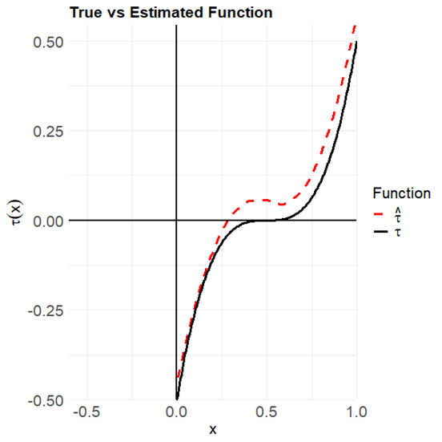
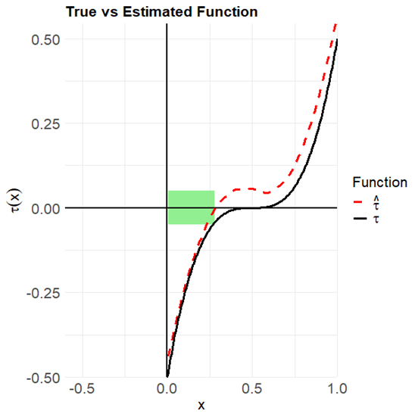
What are we trying to do?
Estimate a function
Identify where it is negative
However, with 51 covariates, in our case, the identifying part gets tricky and complex.

Slide 19
Methods
R packages: SuperLearner, grf, bartMachine
There is an exhaustive list of ML models that could have been used, but DR-Learner, R-Learner and BART are frequently examined in research and have developed packages for use.
Frequentist Approaches (using ML):
Doubly-Robust Learner (DR-Learner)
Residual-Learner (R-Learner)
Bayesian Approach (using Forest-based learning):
Bayesian Additive Regression Trees (BART)

Slide 20
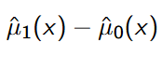
DR-Learner¹ and R-Learner²
Estimated By:
Doubly Robust-Learner (DR-Learner) refines this estimator, by incorporating the propensity scores.
Residual-Learner (R-Learner) does “Residual on Residual regression” and estimates CATE
¹(Künzel et al., 2019)
²(Nie & Wager, 2021)

Slide 21
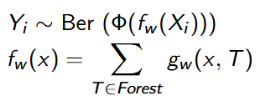

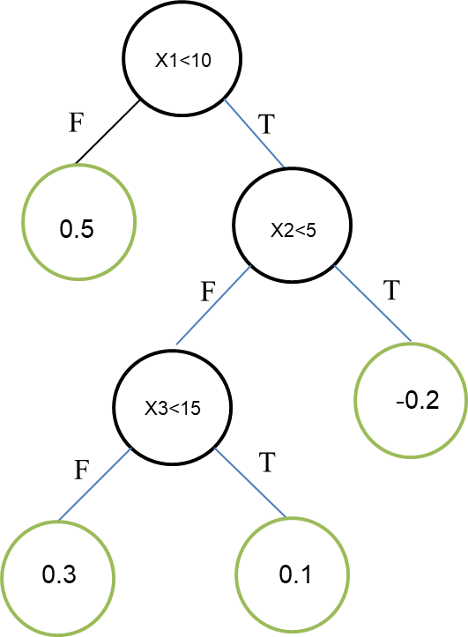
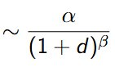
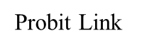
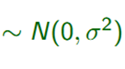
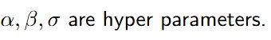
Grow 2 separate forests on the treated and the control population.
Within each forest:
Output from each tree
Bayesian Additive
Regression
Trees³
Depth (d)​
³(Chipman et al., 2010)

Slide 22
Toy Example
5000 data points, 5 covariates, binary outcome
Two arm simulation:
Constant CATE (CATE = -0.10):
Homogeneous treatment effect for every observation
Objective : compare estimator spread when the true effect is uniform
2 Valued CATE:
Effect varies with a single binary covariate
Objective: test each learner’s ability to detect heterogeneity

Slide 23
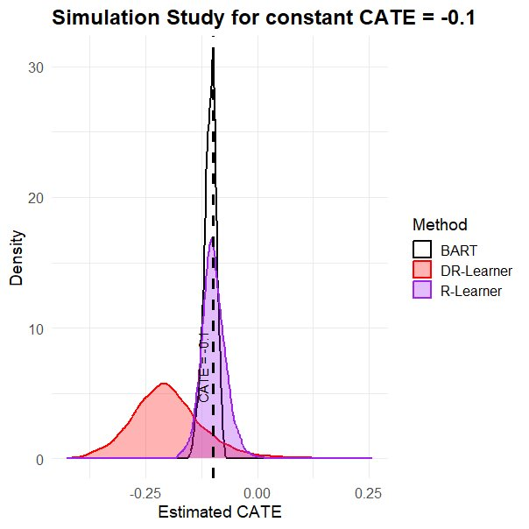
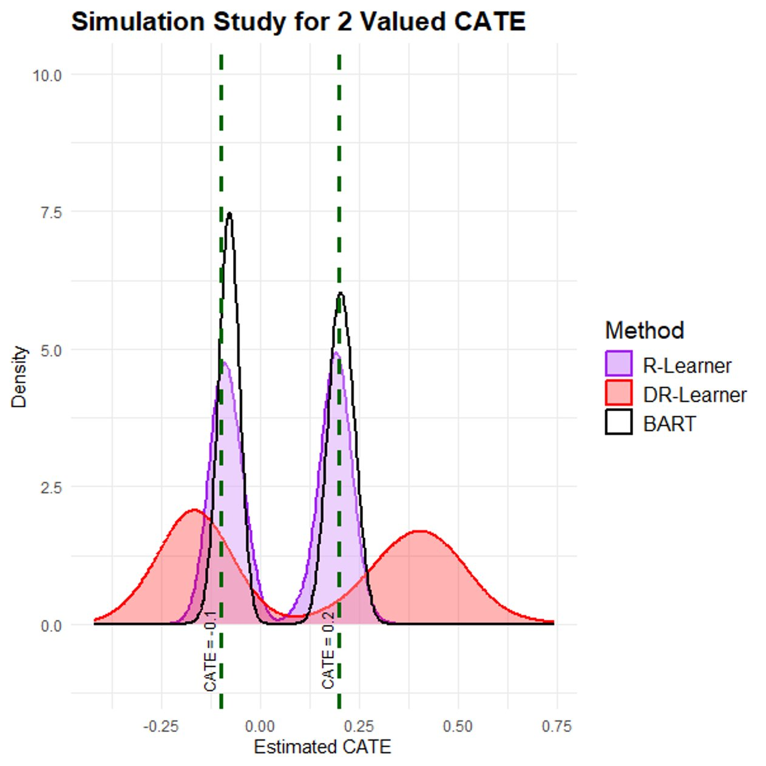
Uni-valued CATE
Bi-valued CATE
Figure 1: Density plots for simulation a) and simulation b)
Under homogeneity and near homogeneity conditions, estimates from BART seem to have a lesser spread followed by DR-Learner and R-Learner
However, the spread pattern might not hold under complex heterogeneity conditions

Slide 24
Applying these to the SUPPORT dataset

Slide 25
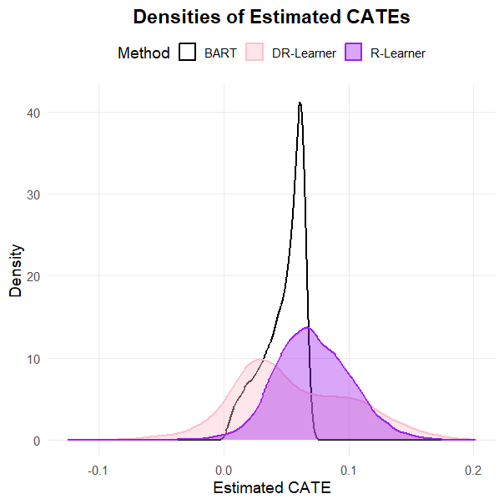
SUPPORT Data: Model Recommendations
n = 5736 patients
DR-Learner: RHC for 537 (9.4%)
R-Learner: RHC for 43 (0.7%)
BART: RHC for 0 patients (0%)
Except 1 patient, everyone recommended RHC by R-Learner were recommended RHC by DR-Learner
RHC Good
RHC Bad
Figure 2: Estimated CATE density plot for DR-Learner, R-Learner and BART

Slide 26
Important Covariate Analysis
How do we define “importance”?
For each covariate, record the percentage reduction in response‐variable (here: estimated CATE) variation across the nodes using this covariate to split on
Sum these %‑decreases over all splits where that covariate is used
Rank covariates by their total %‑decrease: larger totals indicate greater explanatory power
The resulting sorted list gives your variable‐importance ordering

Slide 27
What are the most important categorical covariates driving recommendations?
DR-Learner | R-Learner
Primary Category of Disease​ | Primary Category of Disease​
Presence of Cancer​ | Sex
History of Malignancy​ | Presence of Cancer​
Secondary Category of Disease​ | History of Malignancy​
Sex | History of Immunity
Table 1: Overview of important categorical covariates in both DR-Learner and R-Learner

Slide 28
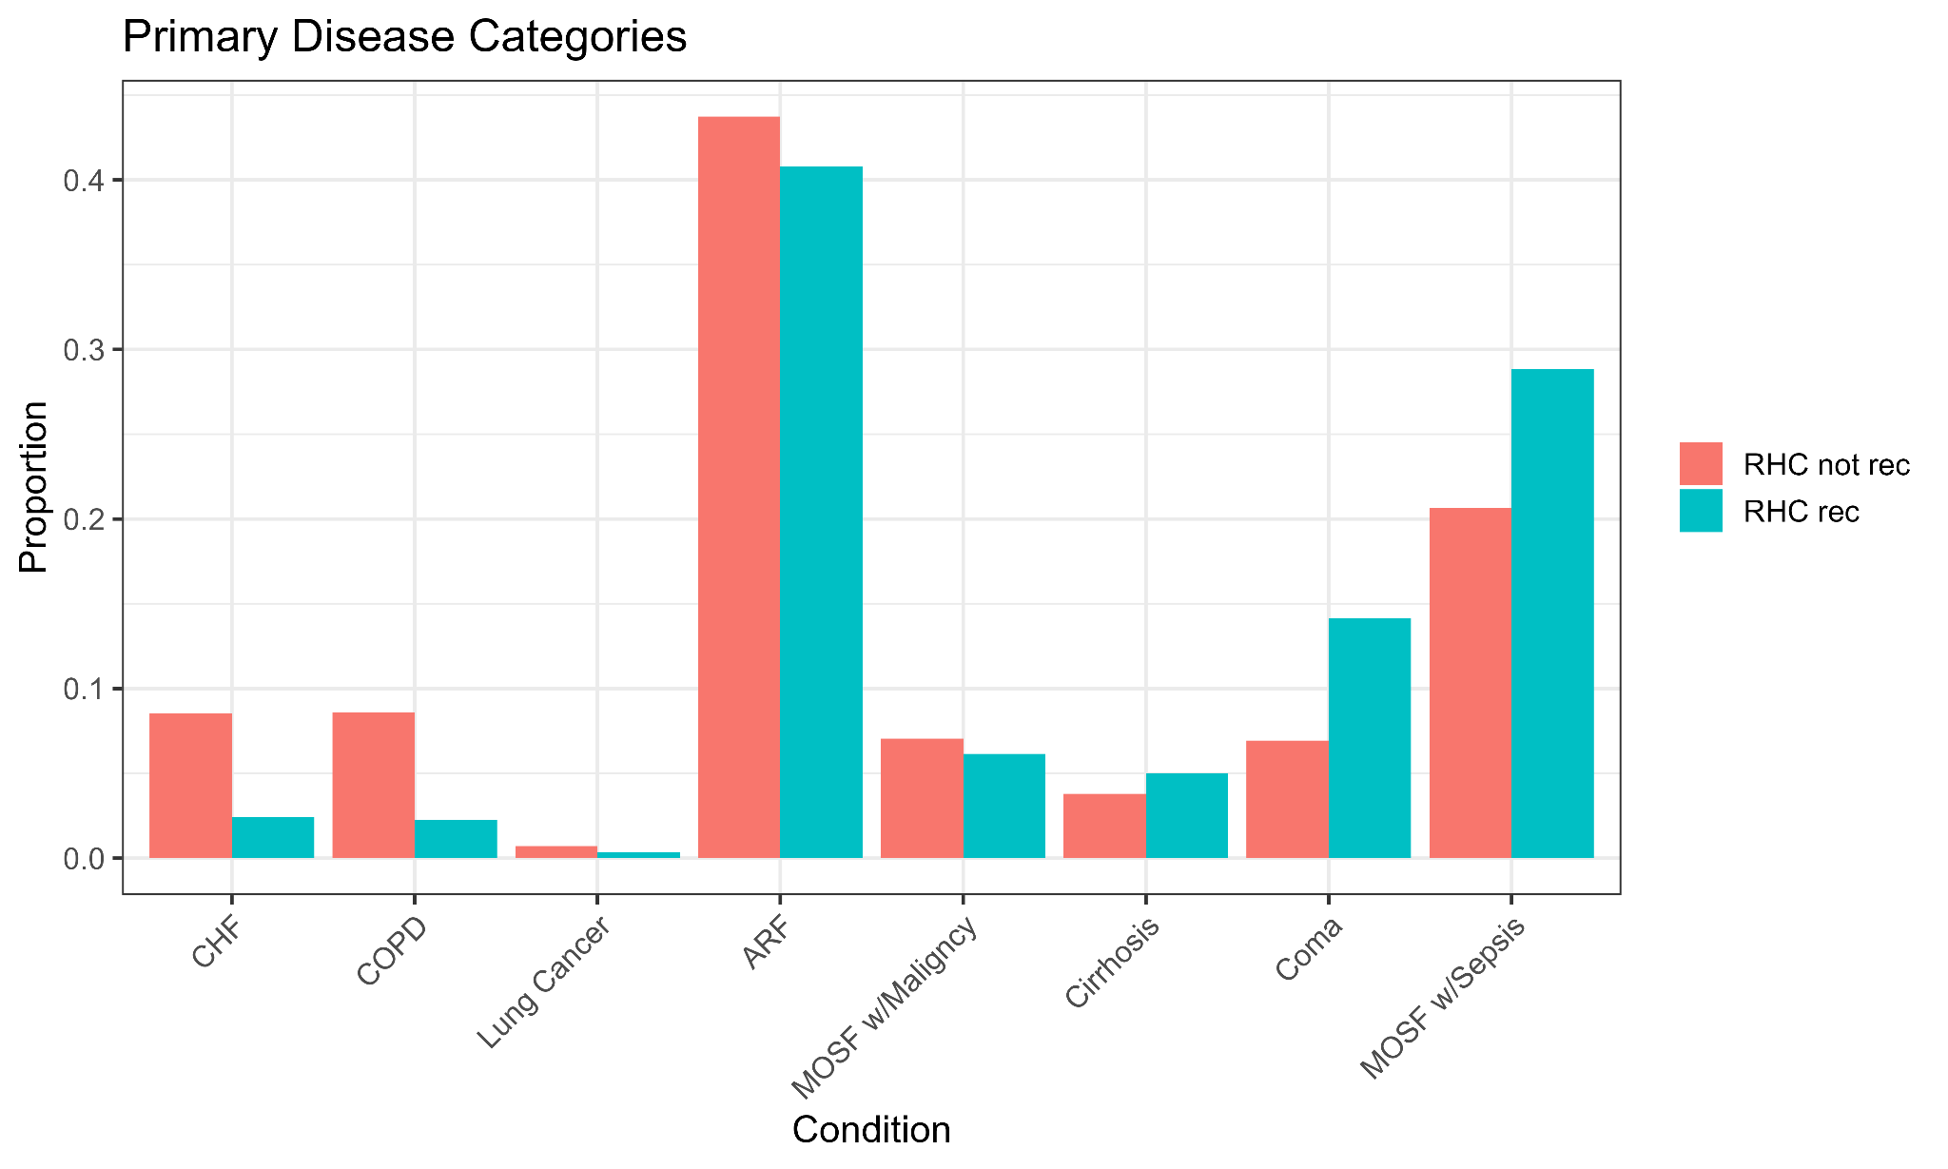
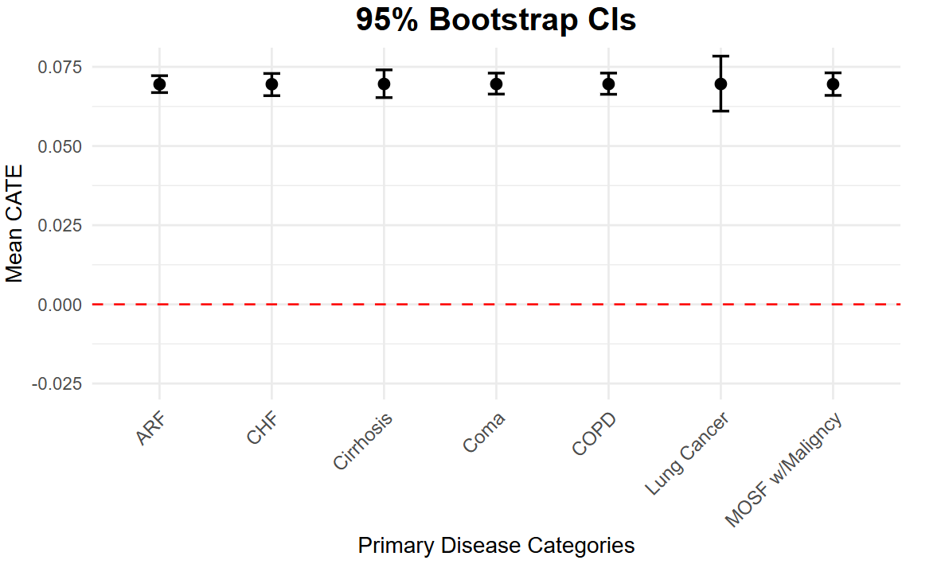
Primary Disease Category
Figure 3: Proportion of patients in each primary disease category, comparing DR‑Learner RHC recommendations versus non‑recommendations
Figure 4: 95 % confidence intervals for the mean causal‑forest–estimated CATE across primary disease categories

Slide 29
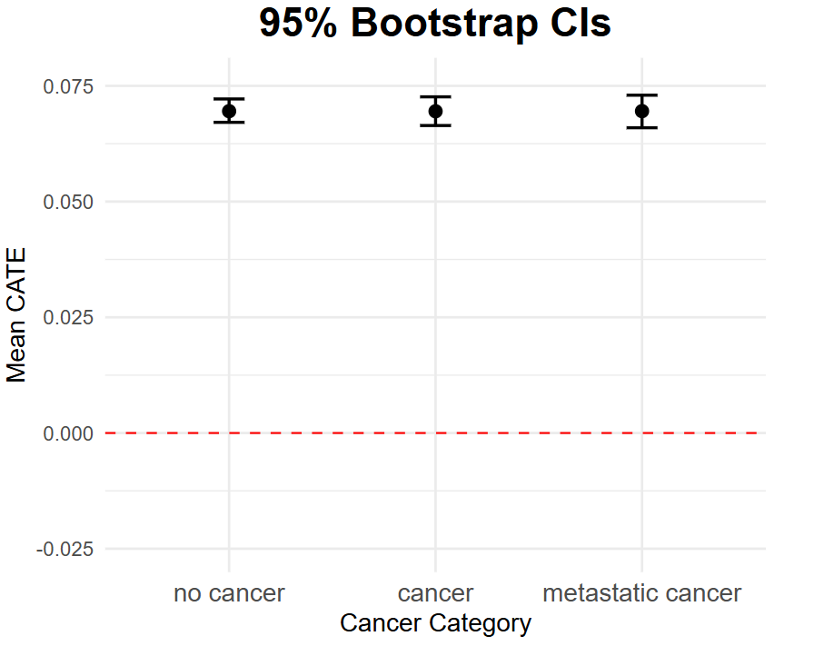
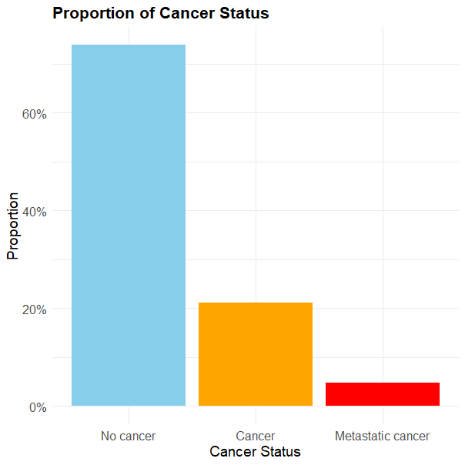
Cancer
After Primary Disease Category, Cancer also gets flagged as one of the most important categorical covariates
Most people who get are recommended RHC are cancer-free
However, being cancer-free does not guarantee RHC benefit
Figure 6: 95% confidence interval of mean CATE values by cancer status
Figure 5: Proportion of patients who have no cancer, cancer, or metastatic cancer

Slide 30
What are the most important continuous covariates driving recommendations?
DR-Learner | R-Learner
Duke Activity Status Index | Bilirubin
Coma Score | Duke Activity Status Index
Age | Coma Score
APACHE Score | Age​
Bilirubin | Albumin
Table 2: Overview of important continuous covariates in both DR-Learner and R-Learner

Slide 31
Expected value of the continuous covariates
Model: DR-Learner
 | RHC Recommended | RHC not recommended
Continuous Covariates | Mean | Mean
Duke Activity Status Index | 23.23 | 20.21
Coma Score | 28.77 | 20.18
Age | 63.20 | 61.18
APACHE Score | 55.56 | 54.59
Bilirubin | 2.54 | 2.24
Table 3: Overview of the most important continuous covariates along with summary statistics for DR-Learner

Slide 32
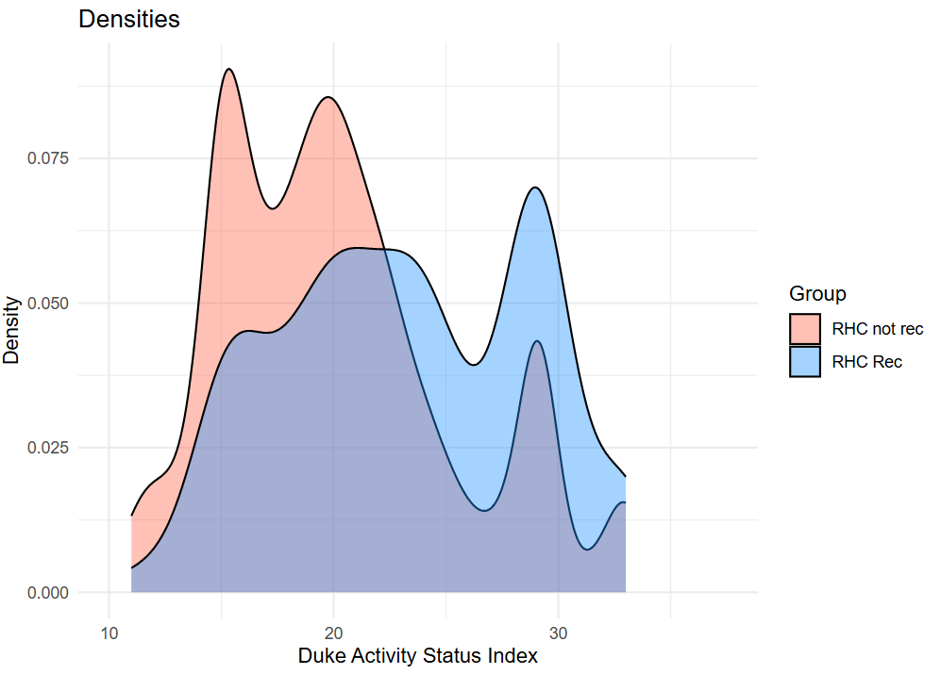
Duke Activity Status Index Analysis
Figure 7: Density of Duke Activity Status Index stratified by DR‑Learner RHC recommendation versus non‑recommendation

Slide 33
Overall Takeaways
RHC was recommended for only a small subset of patients, who are healthier at baseline
Patients not recommended for RHC exhibited higher rates of cardiac and pulmonary disease
No subgroup, including those with no cancer or relatively “healthier” bedside profiles, showed any definitive survival benefit
Further unmeasured covariates may be needed to determine who genuinely benefits from RHC
“Healthier”
Individuals
RHC benefitters

Slide 34
Odds Ratio and Risk Ratios: as causal estimands, they may be different at capturing heterogeneity than risk difference hence their robust estimation is interesting
Assess treatment‑policy value: convert CATE estimates into individualized treatment rules and evaluate expected utility
Clinician‑in‑the‑loop simulation: build an interactive dashboard so clinicians can explore CATE estimates, covariate balance, and predicted outcomes, allowing feedback model refinement
Future Directions

Slide 35
Exploring Treatment Effect Heterogeneity with Time-To-Event Outcomes
Abhroneel Ghosh – Indian Statistical Institute, Kolkata
Leo Hickey – Vassar College
Quinn Hungerford – University of Texas at Austin
Isabella Summe – University of Chicago
Notes:
While the previous group explored treatment heterogeneity using binary survival outcomes, our project takes it a step further by examining how the treatment effects of RHC vary over time using time-to-event data.

Slide 36
How can the implementation of time-to-event analysis techniques explore heterogeneity in the causal effect of RHC and identify clinically significant patient subpopulations?
Research Question
Notes:
Our core question is: how can time-to-event models help us uncover which patient groups benefit or are harmed by RHC, and guide more personalized clinical decisions based on that heterogeneity?

Slide 37

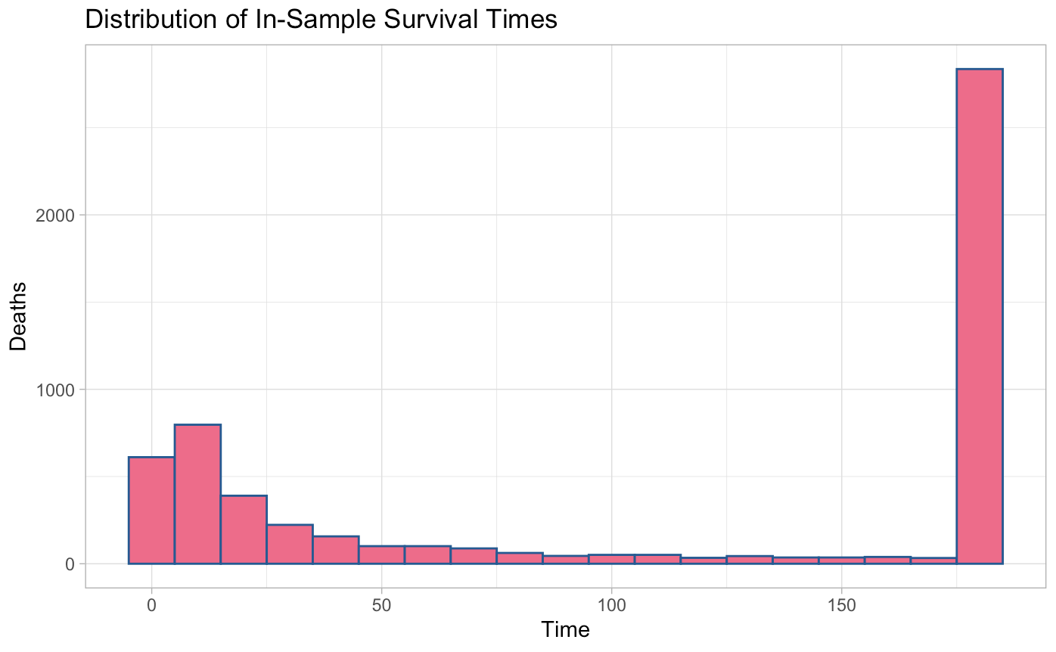
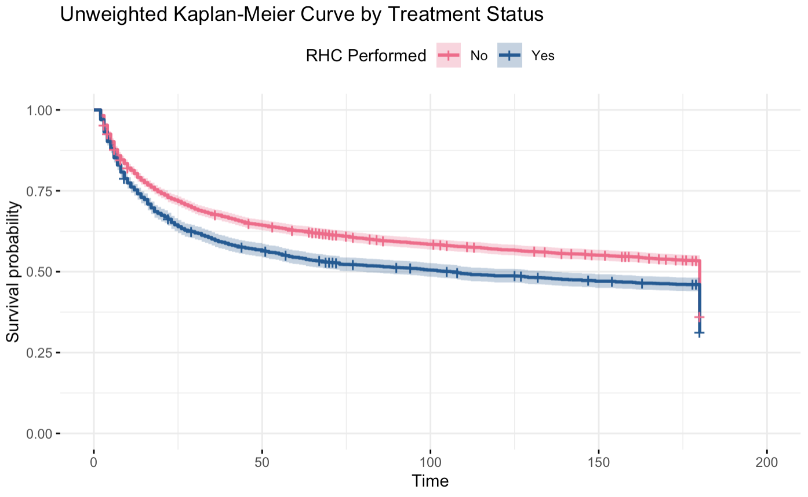
Introduction to Survival Analysis
Causal Assumptions
All previous assumptions plus…
Independence of censoring
Proportional hazards
Increased parameter information at complexity cost.
3.2% non-administratively right censored:
max(last contacted date, discharge date) < 180 days

Slide 38
Causal Estimator for Time-To-Event Inference
Conditional Average Treatment Effects (CATEs) are estimated using the difference in Restricted Mean Survival Time (RMST) up to a fixed time horizon (180 days)
RMST vs other outcomes (including hazard ratio):
causally interpretable, better integrates information over time¹, more consistent
Choosing 180-day horizon: clinically relevant and balanced
Time Horizon | 30 day | 90 day | 180 day
% death observed | 33.4% | 43.7% | 49.3%
¹Stensrud et al, 2019

Slide 39
Background on Models
 | DeepSurv² | Causal Survival Forest (CSF)³
Goal | Predict survival probabilities | Estimate heterogeneous treatment effect (HTE)
Method | Neural network extension of Cox Regression model | Survival tree-based extension of random forests
Focus | Designed to have strong predictive power | Splits to maximize treatment effect differences
Limitations | Assumes proportional hazards; less interpretable | Does not directly predict survival or have measurable performance indicator
R Packages | reticulate, dnn | grf
²Katzman et al., 2024
³Cui et al., 2023
Notes:
We chose two models for our analysis: DeepSurv and Causal Survival Forest.
DeepSurv is a neural network extension of the Cox model designed to predict survival probabilities. It reaches high predictive accuracy by learning a nonlinear risk function of how patient covariates influence survival over time. However, it assumes proportional hazards and can be less interpretable.
In contrast, Causal Survival Forests are designed to estimate heterogeneous treatment effects by splitting based on treatment effect differences. They differ from DeepSurv by estimating how much the RHC treatment is expected to improve or worsen a patient’s survival outcome (in other words, the RMST difference at 180 days). The downside of CSFs is that they don’t produce direct standard survival predictions or performance metrics like the C-index.

Slide 40
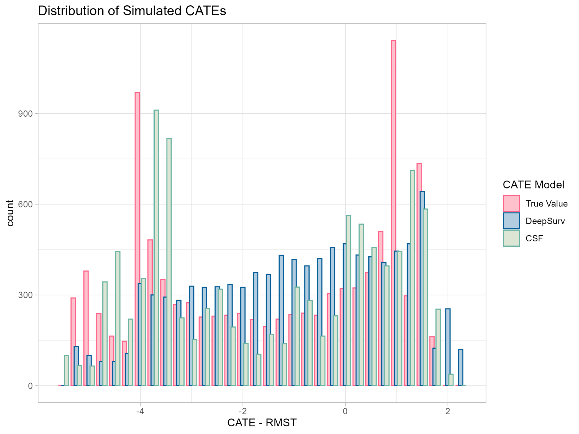
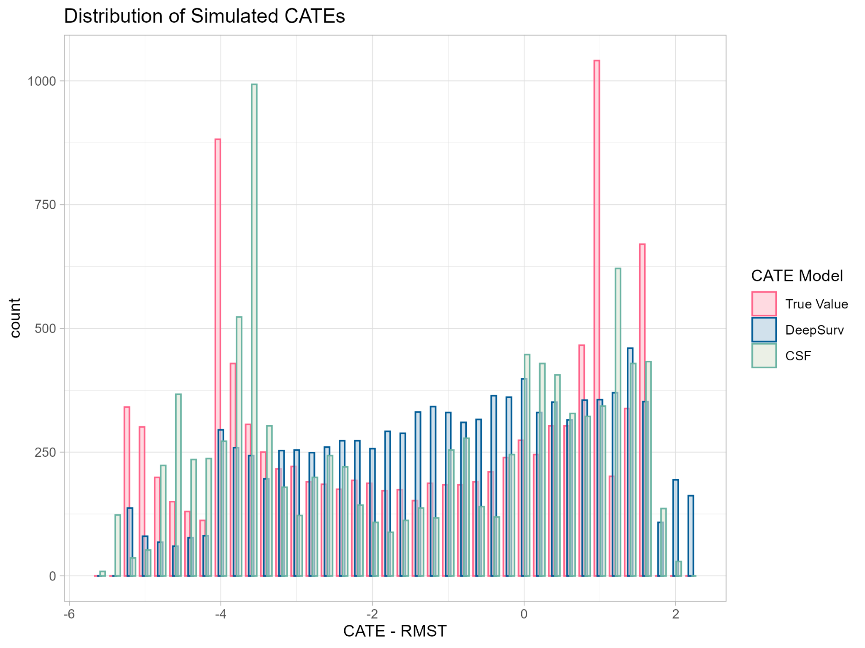
Model Evaluation and Comparison
5-Fold Cross-validation Comparison
Toy Example Comparison
Model | Mean C-Index
IPW-Cox with interaction | 0.6860
DeepSurv | 0.7095
DeepSurv demonstrates strong predictive accuracy and aligns closely with both the true simulated CATE values and CSF estimates
CSF lacks conventional evaluation metrics, but excels at estimating CATEs and outperforms in simulation studies
Notes:
Here, we evaluate and compare the two models’ performance.
First looking at prediction performance, we used 5-fold cross-validation to compare concordance index values. Our baseline Cox model’s C-index was 0.68. DeepSurv performed slightly better at 0.7, showing it has higher discriminative ability for survival outcomes.
On the right, we simulated a toy example of a single sample of 10,000 individuals with linear HTE that evaluates how well each model estimates the true treatment effect, or CATE, for individual patients. The pink bars represent the true CATE distribution, while the blue and green bars show the distributions estimated by DeepSurv and CSF.
DeepSurv aligns moderately well, but CSF captures more of the variation across the full distribution.
Together, DeepSurv and CSF provide a balanced approach: one optimized for prediction, the other for estimating treatment effect variation.

Slide 41
Framework for Identifying Heterogeneity
Optimize prediction:
Identify influential variables in
survival risk
Identifying Clinically Relevant Patient Subpopulations
DeepSurv
Validation⁴
Integrate survival prediction and treatment effect heterogeneity to guide targeted research and decision-making
Optimize heterogeneity:
`
Causal Survival Forest (CSF)
Identify key drivers of variation in treatment effect
⁴Noroozizadeh et al., 2024
Notes:
Bella:
As Quinn has outlined, DeepSurv and Causal Survival Forests are designed with different goals in mind.
So, we designed a framework using these two models to identify treatment effect heterogeneity
With DeepSurv, we optimized for survival prediction
(as DeepSurv generates survival risk scores)
Using a Causal Survival Forest, we optimized for treatment effect differences
(as CSF targets heterogeneity, not survival prediction)
(by directly estimating the treatment effect (difference in CATE))
So, we propose that by using a Causal Survival Forest as a baseline to validate our treatment effect findings from DeepSurv, we can more robustly identify clinically relevant patient subgroups
This aligns with previous literature integrating survival prediction and treatment effect heterogeneity

Slide 42
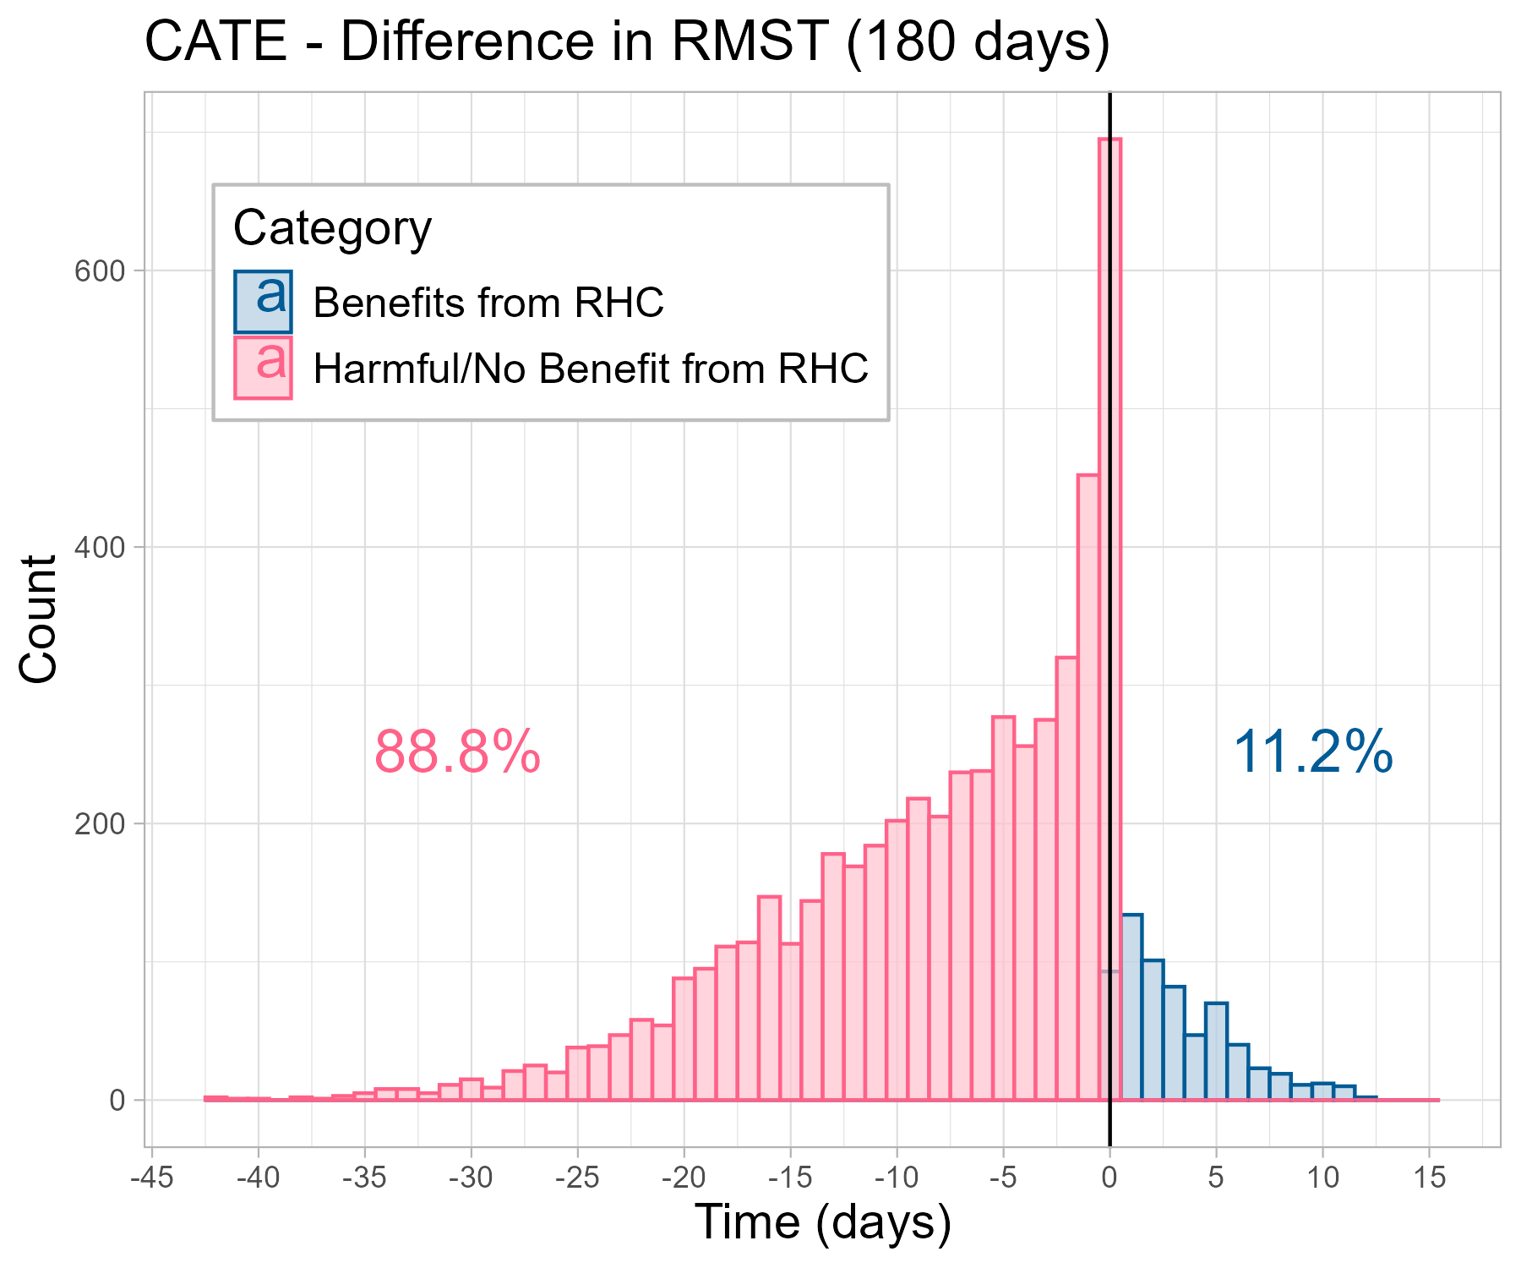
DeepSurv Results
Decision Tree (Regression of Estimated CATEs):
Subgroup Identification to Inform Clinical Decisions
RMST 180-day CATE Distribution
Respiratory Rate
≥ 25 bpm
< 25 bpm
Mean Arterial Pressure
Primary Disease
< 73 mm Hg
≥ 73 mm Hg
ARF, CHF, Colon or Lung Cancer
Other
Most patients show little or no effect
Majority show negative effect of RHC, small subpopulation that benefits
Subgroup Effect: -0.56
Population: 11%
Subgroup Effect: -10
Population: 39%
Subgroup Effect: -6
Population: 25%
Subgroup Effect: -5.6
Population: 25%
Notes:
Here is the 180-day CATE distribution estimated using DeepSurv. On the left, you can see that most patients fall near zero, indicating little or no treatment effect from RHC. About 89% of patients are estimated to experience a neutral or negative effect, while only 11% show a clear survival benefit. This reinforces prior findings that RHC may not be broadly beneficial, but could help a small, specific subgroup.
To better understand who these patients are, we regressed the estimated CATEs on patient features using a decision tree, shown on the right. The top split is respiratory rate, so patients with higher rates (over 25 bpm) tend to experience worse outcomes. Within that group, those with low mean arterial pressure had the largest negative effect, averaging a 10-day reduction in 180-day survival.
Among patients with lower respiratory rates, primary disease type helped identify smaller subgroups, though their average effects were less severe.
Together, these results suggest that DeepSurv not only provides individualized treatment estimates, but also helps inform clinical decision-making by identifying high-risk groups.

Slide 43
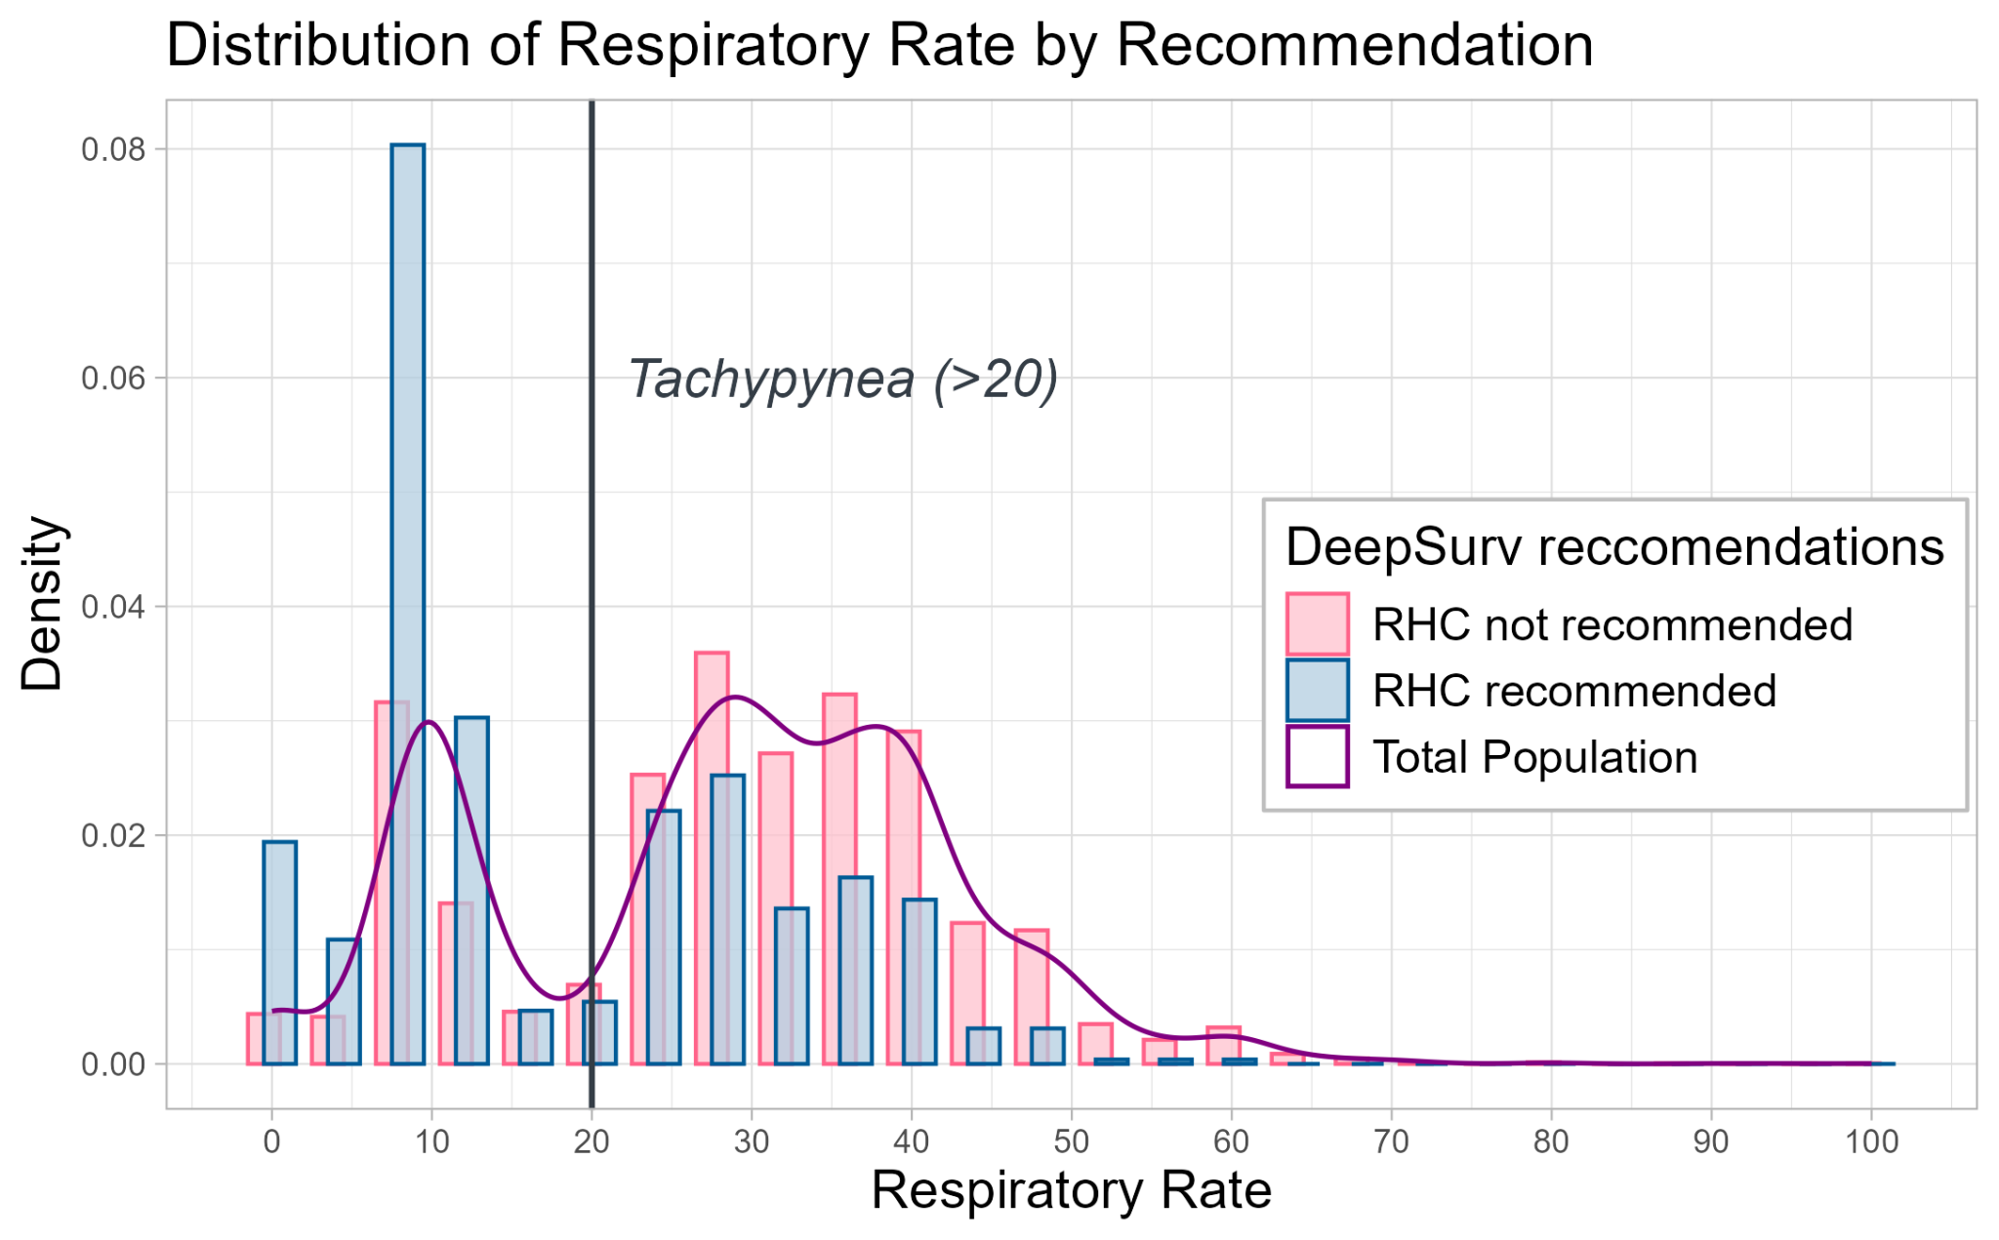
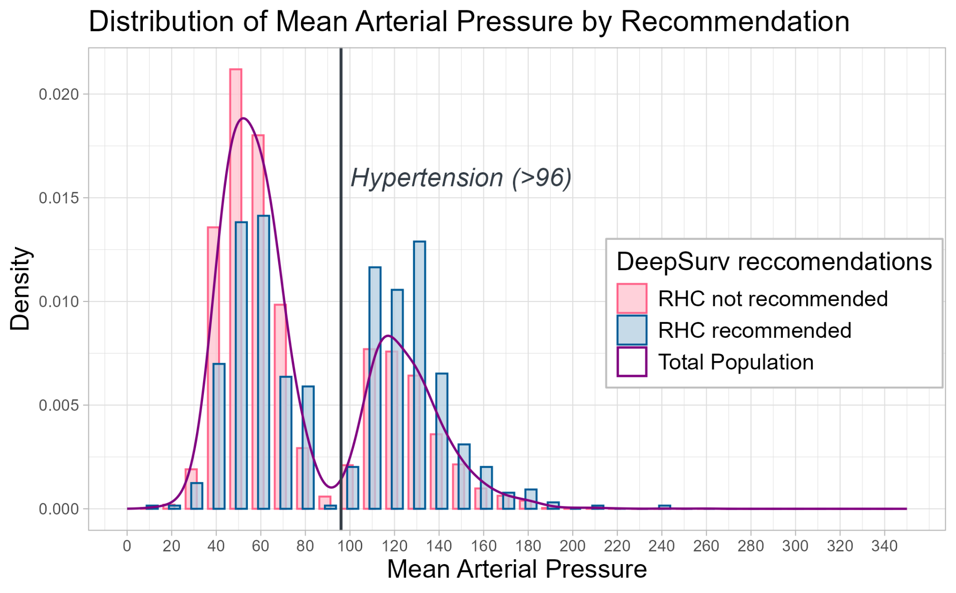
Discussing Key Covariates
Respiratory Rate and Mean Arterial Pressure identified as most important
Clear bimodal population with clinically meaningful thresholds
Populations with estimated +ve/-ve effect of RHC have different distributions
May be indicative of underlying medical interactions
Notes:
From our RMST analysis, approx 89% of participants were in the "no benefit or potentially harmed by RHC" category
DeepSurv identified respiratory rate and mean arterial pressure as key variables in survival prediction.
These graphs show their distribution by treatment recommendation – whether DeepSurv recommends RHC or not (based on the sign of their estimated subgroup effect) (CATEs - conditional average treatment effect)
For both of these variables, we observe bimodal populations – suggesting two distinct patient subgroups. These subgroups align with clinically meaningful thresholds:
For mean arterial pressure, the distributions diverge near the cutoff for hypertension
Similarly for respiratory rate, the distributions are split by the threshold for tachypnea
These patterns indicate that patients past these thresholds are less likely to benefit from RHC. The observed treatment effect heterogeneity may reflect underlying physiological mechanisms or interactions with illness severity

Slide 44
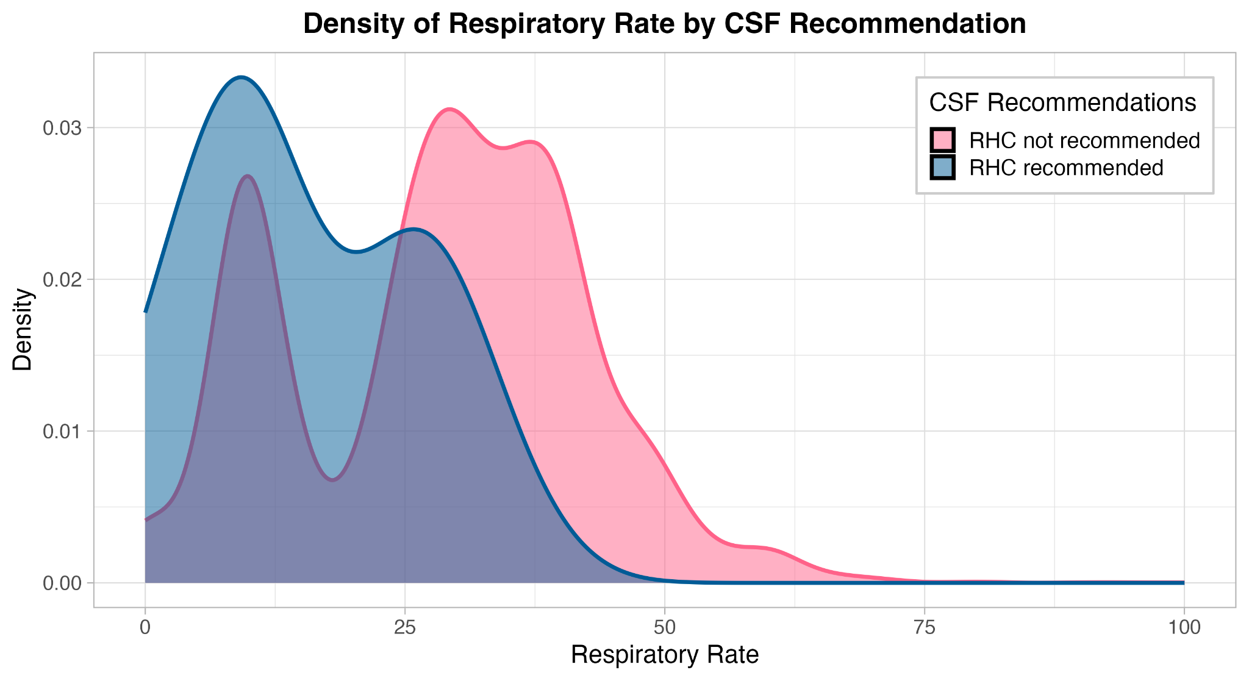
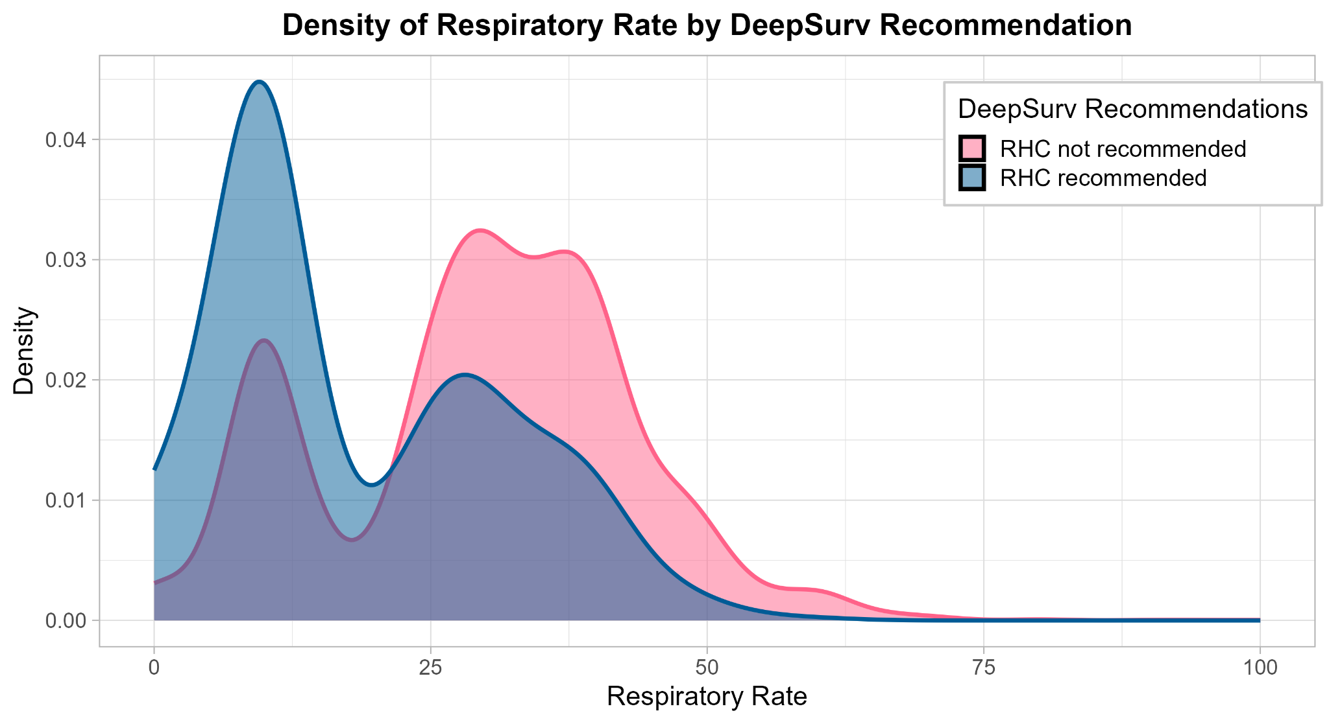
Validation With Causal Survival Forest
DeepSurv Identifies:
CSF Identifies:
i. Respiratory Rate
ii. Mean Arterial Pressure
iii. Primary Disease
i. Respiratory Rate
ii. Mean Arterial Pressure
iii. APACHE Score
(severity)
Clinicians may consider these variables as they:
predict survival
drive variation in treatment effect
Notes:
Bella:
As Abhroneel mentioned, DeepSurv identified respiratory rate, mean arterial pressure, and primary disease as key variables (in survival prediction)
Similarly, the causal survival forest model also identified respiratory rate and mean arterial pressure, as well as the APACHE score (measure of illness severity), as key drivers of treatment effect heterogeneity – that is, whether RHC is likely to help or harm a patient.
This overlap validates our findings and highlights the importance of these variables in both survival prediction and treatment effect variation
As an example, the graphs on the right show the distribution of respiratory rate by model-recommended treatment – from CSF (top) and DeepSurv (bottom)
Both models suggest that patients with higher respiratory rates (above ~25) are generally not recommended for RHC
Further, the divergence in the density curves reflects treatment effect heterogeneity for this variable
Together, these models suggest that these variables (respiratory rate and mean arterial pressure) are not only prognostic (predict the outcome), but also actionable – helping clinicians identify subgroups most likely to benefit from or be harmed by RHC
(those with positive CATEs and those with negative CATEs)

Slide 45
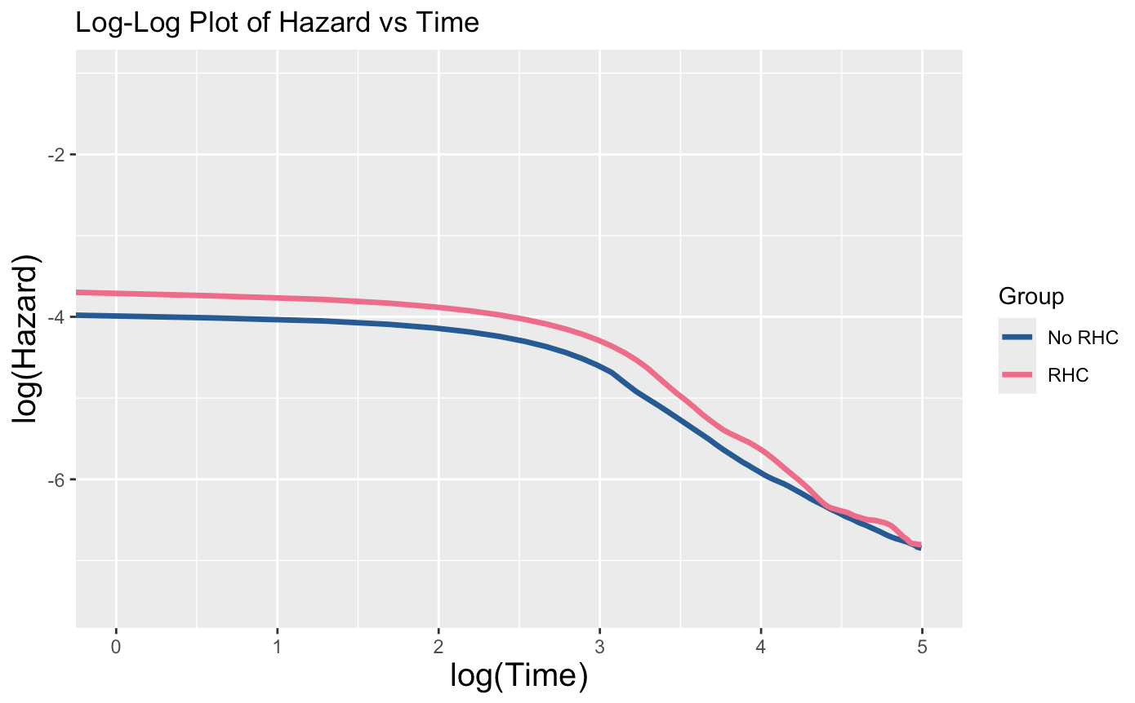
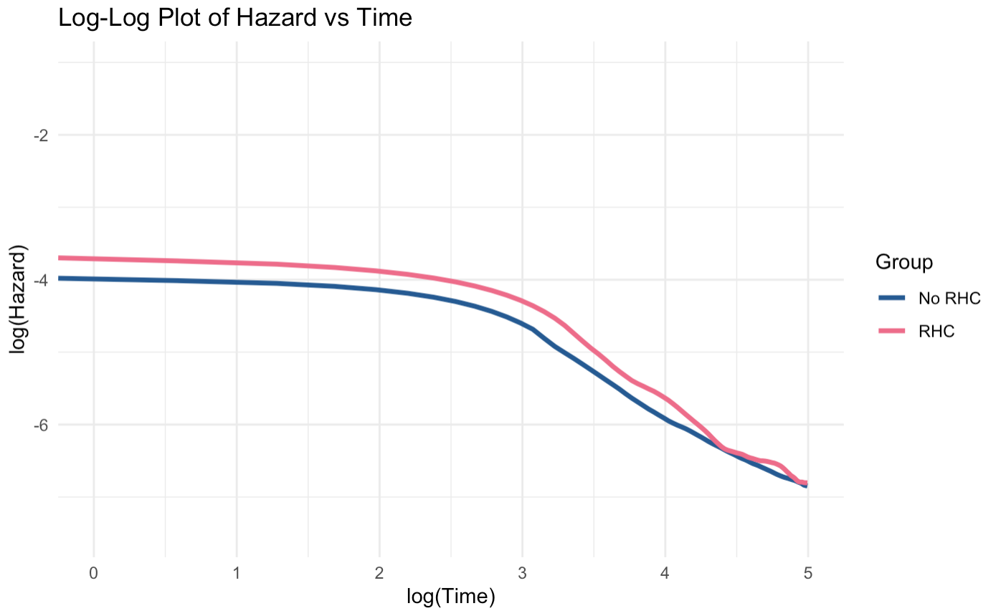
Limitations and Future Scope
2. Contending with Simplifying Assumptions
Ex: Non-proportionality
Maximizing Clinical Relevance of Models
Improving RMST estimate
Variance | Bias
Quantifying uncertainty: bootstrapping for DeepSurv results | Validating on external datasets to address problems with SUPPORT 29 years old Left truncation/ missing data
Consistent with:
Clinical intuition
Findings that favor accelerated failure time⁵
AFT-BART
3. The WHY!
⁵Stroustrup et al., 2016;
Hu et al., 2020

Slide 46
Overall Takeaways
Overwhelming evidence corroborating original study:
Right heart catheterization appears to be a harmful intervention overall — But average treatment effect obscures treatment individualization
Binary outcome analysis Cancer status Primary disease category | Time-to-event analysis Blood pressure Respiratory rate Primary disease category
What factors drive heterogeneity for RHC treatment effect?
Expanding composite multi-model framework to other interventions!
Notes:
RHC is at most recommended for a very minor proportion of the individuals
From group #2: these are healthier patients at baseline (without history)
Primary disease
Cancer, etc.
From our group:
This framework we applied to the SUPPORT study provides a template of how we can approach future studies

Slide 47
Acknowledgements
We would like to thank Dr. Fan Li and Dr. Lee Kennedy-Shaffer for making this research possible, as well as our amazing graduate student instructors Jiaqi Tong and Xi Fang for their continued support and guidance throughout the projects. We would also like to thank the entire BDSY team, especially Dr. Bhramar Mukherjee, for organizing this program and guiding us in making an impact through our research.

Slide 48
References (Average Treatment Effect)
Manda, Y. R., & Baradhi, K. M. (2023). Cardiac Catheterization Risks and Complications. PubMed; StatPearls Publishing. https://www.ncbi.nlm.nih.gov/books/NBK531461
Katbamna, B., Wu, L., Rodriguez, M., King, P., Schilling, J., Mahar, J., Nair, A. P., Jneid, H., Klings, E. S., Weinhouse, G. L., Mazimba, S., Simon, M. A., Strauss, M., & Krittanawong, C. (2024). The uses of right heart catheterization in cardio-pulmonary disease: State-of-the-art. American Heart Journal Plus: Cardiology Research and Practice, 49, 100488. https://doi.org/10.1016/j.ahjo.2024.100488
Connors A.F., Dawson N.V., Desbiens N.A., et al. (1995). A Controlled Trial to Improve Care for Seriously III Hospitalized Patients: The Study to Understand Prognoses and Preferences for Outcomes and Risks of Treatments (SUPPORT). JAMA. 1995;274(20):1591–1598. https://jamanetwork.com/journals/jama/fullarticle/391724
Naimi, A. I., & Whitcomb, B. W. (2023). Defining and Identifying Average Treatment Effects. American Journal of Epidemiology. https://doi.org/10.1093/aje/kwad012
Austin, P. C. (2011). An Introduction to Propensity Score Methods for Reducing the Effects of Confounding in Observational Studies. Multivariate Behavioral Research, 46(3), 399–424.
Funk, M. J., Westreich, D., Wiesen, C., Stürmer, T., Brookhart, M. A., & Davidian, M. (2011). Doubly Robust Estimation of Causal Effects. American Journal of Epidemiology, 173(7), 761–767. https://doi.org/10.1093/aje/kwq439
Luque‐Fernandez, M. A., Schomaker, M., Rachet, B., & Schnitzer, M. E. (2018). Targeted maximum likelihood estimation for a binary treatment: A tutorial. Statistics in Medicine, 37(16), 2530–2546. https://doi.org/10.1002/sim.7628‌
Tan, Y. V., & Roy, J. (2019). Bayesian additive regression trees and the General BART model. Statistics in Medicine, 38(25), 5048–5069. https://doi.org/10.1002/sim.8347

Slide 49
References (Binary HTE Analysis)
Künzel, S. R., Sekhon, J. S., Bickel, P. J., & Yu, B. (2019). Metalearners for estimating heterogeneous treatment effects using machine learning. Proceedings of the National Academy of Sciences, 116(10), 4156‑4165. [https://doi.org/10.1073/pnas.1804597116](https://doi.org/10.1073/pnas.1804597116)
Nie, X., & Wager, S. (2021). Quasi‑Oracle Estimation of Heterogeneous Treatment Effects. Biometrika, 108(2), 299‑319. Preprint: [https://arxiv.org/abs/1712.04912](https://arxiv.org/abs/1712.04912)
Chipman, H. A., George, E. I., & McCulloch, R. E. (2010). BART: Bayesian additive regression trees. The Annals of Applied Statistics, 4(1), 266‑298. [https://doi.org/10.1214/09‑AOAS285](https://doi.org/10.1214/09‑AOAS285)
Rubin, D. B. (1980). Randomization analysis of experimental data: The Fisher randomization test comment. Journal of the American Statistical Association, 75(371), 591‑593. [https://doi.org/10.1080/01621459.1980.10483031](https://doi.org/10.1080/01621459.1980.10483031)
Rosenbaum, P. R., & Rubin, D. B. (1983). The central role of the propensity score in observational studies for causal effects. *Biometrika, 70*(1), 41‑55. [https://doi.org/10.1093/biomet/70.1.41](https://doi.org/10.1093/biomet/70.1.41)
Crump, R. K., Hotz, V. J., Imbens, G. W., & Mitnik, O. A. (2009). Dealing with limited overlap in estimation of average treatment effects. Biometrika, 96(1), 187‑199. [https://doi.org/10.1093/biomet/asn055](https://doi.org/10.1093/biomet/asn055)

Slide 50
References (Time-to-Event HTE Analysis)
Connors AF Jr, Speroff T, Dawson NV, Thomas C, Harrell FE Jr, Wagner D, Desbiens N, Goldman L, Wu AW, Califf RM, Fulkerson WJ Jr, Vidaillet H, Broste S, Bellamy P, Lynn J, Knaus WA. The effectiveness of right heart catheterization in the initial care of critically ill patients. SUPPORT Investigators. JAMA. 1996 Sep 18;276(11):889-97. doi: 10.1001/jama.276.11.889. PMID: 8782638.
Hu L, Ji J, Li F. Estimating heterogeneous survival treatment effect in observational data using machine learning. Stat Med. 2021 Sep 20;40(21):4691-4713. doi: 10.1002/sim.9090. Epub 2021 Jun 10. PMID: 34114252; PMCID: PMC9827499.
Katzman, J.L., Shaham, U., Cloninger, A. et al. DeepSurv: personalized treatment recommender system using a Cox proportional hazards deep neural network. BMC Med Res Methodol 18, 24 (2018). https://doi.org/10.1186/s12874-018-0482-1
Stroustrup N, Anthony WE, Nash ZM, Gowda V, Gomez A, López-Moyado IF, Apfeld J, Fontana W. The temporal scaling of Caenorhabditis elegans ageing. Nature. 2016 Feb 4;530(7588):103-7. doi: 10.1038/nature16550. Epub 2016 Jan 27. PMID: 26814965; PMCID: PMC4828198.
Yifan Cui, Michael R Kosorok, Erik Sverdrup, Stefan Wager, Ruoqing Zhu, Estimating heterogeneous treatment effects with right-censored data via causal survival forests, Journal of the Royal Statistical Society Series B: Statistical Methodology, Volume 85, Issue 2, April 2023, Pages 179–211, https://doi.org/10.1093/jrsssb/qkac001
Mats J Stensrud, John M Aalen, Odd O Aalen, Morten Valberg, Limitations of hazard ratios in clinical trials, European Heart Journal, Volume 40, Issue 17, 1 May 2019, Pages 1378–1383, https://doi.org/10.1093/eurheartj/ehy770
Noroozizadeh, Shahriar & Welle, Pim & Weiss, Jeremy & Chen, George. (2025). The Impact of Medication Non-adherence on Adverse Outcomes: Evidence from Schizophrenia Patients via Survival Analysis.

Slide 51
